Slide 1

CSCI 476: Computer Security
Set-UID and Environment Variables
Reese Pearsall
Fall 2024
*all images are stolen from the internet
https://www.cs.montana.edu/pearsall/classes/fall2024/476/main.html

Slide 2
Announcements
Course Website is fixed
Lab 1 posted, due Sunday September 22nd

Slide 3
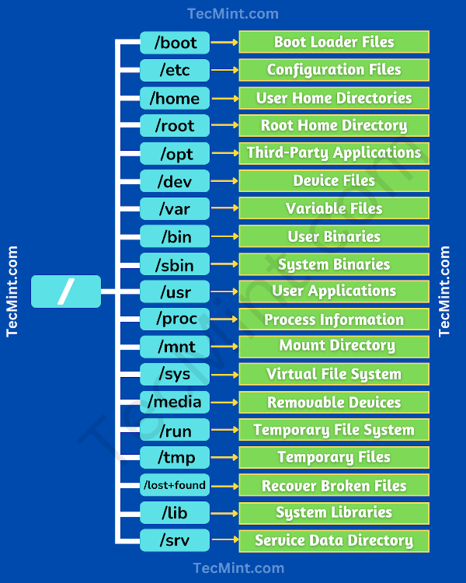
/etc – configuration files
/etc/passwd → User account information
/etc/shadow → Hashed Passwords
/etc/hosts → IP Addresses to Hostname Configs
/etc/resolv.conf → Configuration for DNS server

Slide 4
/etc – configuration files
/etc/passwd → User account information
/etc/shadow → Hashed Passwords
/etc/hosts → IP Addresses to Hostname Configs
/etc/resolv.conf → Configuration for DNS server
/home – Home directory
/home/csci-476 → CSCI 476 code repo

Slide 5
/etc – configuration files
/etc/passwd → User account information
/etc/shadow → Hashed Passwords
/etc/hosts → IP Addresses to Hostname Configs
/etc/resolv.conf → Configuration for DNS server
/home – Home directory
/home/csci-476 → CSCI 476 code repo
/var – Variable files (caches and logs)
/home/log/ → contains log files generated by services

Slide 6
/etc – configuration files
/etc/passwd → User account information
/etc/shadow → Hashed Passwords
/etc/hosts → IP Addresses to Hostname Configs
/etc/resolv.conf → Configuration for DNS server
/home – Home directory
/home/csci-476 → CSCI 476 code repo
/var – Variable files (caches and logs)
/home/log/ → contains log files generated by services
/bin – Binaries for commands
/bin/ls → Binary for ls command
/bin/mkdir → Binary for mkdir command

Slide 7
/etc – configuration files
/etc/passwd → User account information
/etc/shadow → Hashed Passwords
/etc/hosts → IP Addresses to Hostname Configs
/etc/resolv.conf → Configuration for DNS server
/home – Home directory
/home/csci-476 → CSCI 476 code repo
/var – Variable files (caches and logs)
/home/log/ → contains log files generated by services
/bin – Binaries for commands
/bin/ls → Binary for ls command
/bin/mkdir → Binary for mkdir command
/tmp – Temporary files
Does not have persistence
We will occasionally put stuff there

Slide 8
How would you protect your computer and its resources?

Slide 9
Access Control
who can do what to whom?
users/groups
what is their identity?
Objects
Usually things on a filesystem
permissions (read/write/execute)
Ok, I know the who– what are you permitted to do?

Slide 10
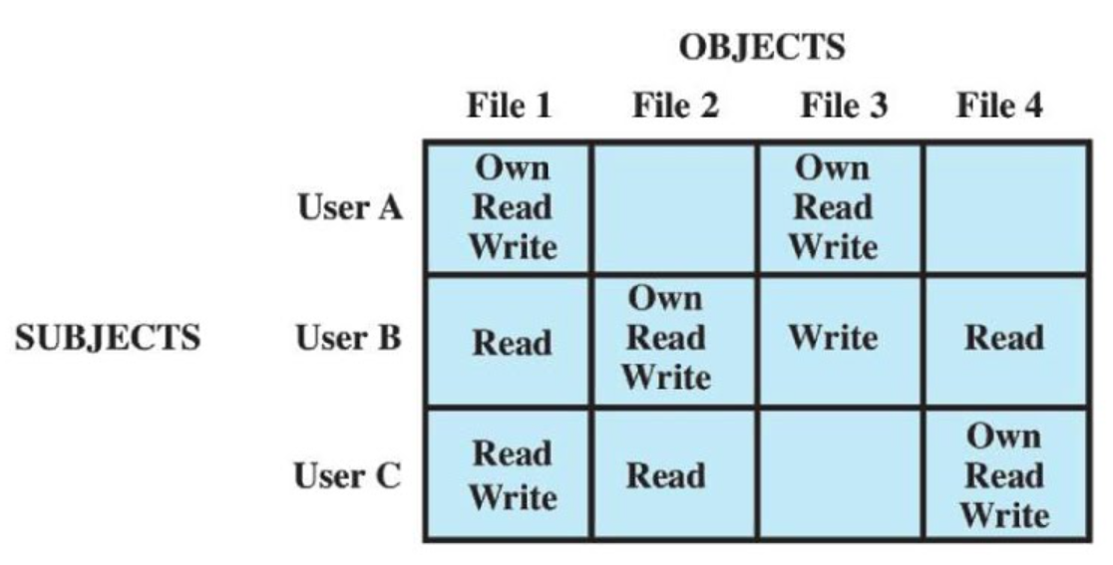
who can do what to whom?
Access Control
Access Control Matrix
What are some issues with this?

Slide 11
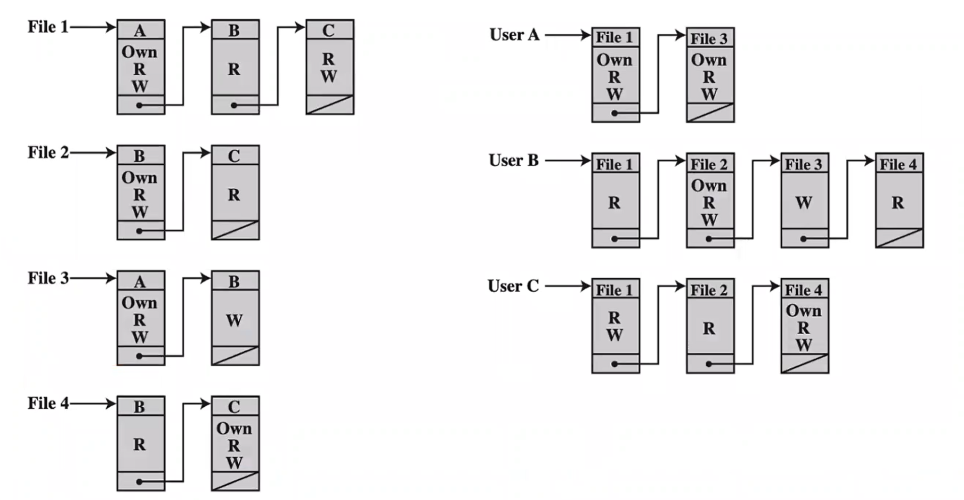
who can do what to whom?
Access Control
Wont take up as much memory!
Access Control list (ACL)

Slide 12
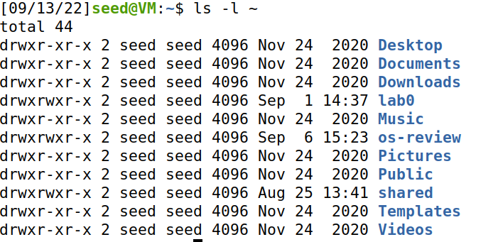
Unix File Modes and Permissions
Every Unix file has a set of permissions that determine whether someone can read, write, or run the file
ls –l ~
ls –l /dev

Slide 13
Unix File Modes and Permissions
Every Unix file has a set of permissions that determine whether someone can read, write, or run the file
ls –l ~
ls –l /dev
Permissions for the file

Slide 14
Unix File Modes and Permissions
Every Unix file has a set of permissions that determine whether someone can read, write, or run the file
Owner/group information
ls –l ~
ls –l /dev
Permissions for the file

Slide 15
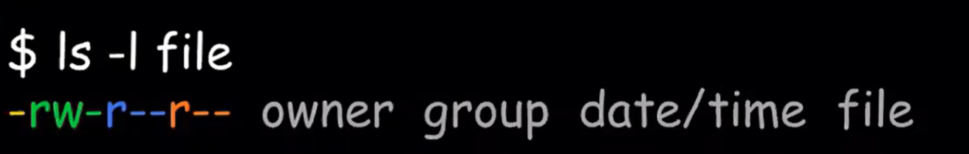
Unix File Modes and Permissions
Every Unix file has a set of permissions that determine whether someone can read, write, or run the file
File permissions (4 parts)
[file type][user][group][other]

Slide 16
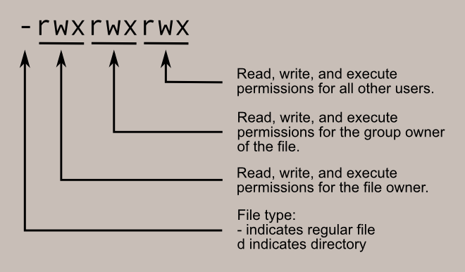
Unix File Modes and Permissions
File permissions (4 parts)
[file type][user][group][other]

Slide 17
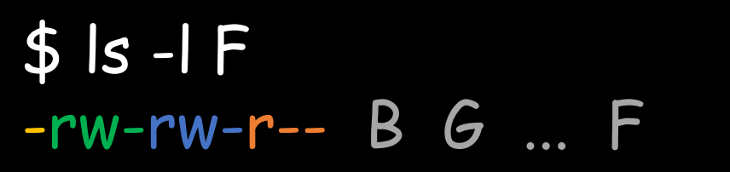
Unix File Modes and Permissions
[file type][user][group][other]
Suppose you have the following file:
If user A asks to perform some operation O on a file object F, the OS checks:
Is A the owner of F?

Slide 18

Unix File Modes and Permissions
[file type][user][group][other]
Suppose you have the following file:
If user A asks to perform some operation O on a file object F, the OS checks:
Is A the owner of F?
No, B is the owner

Slide 19
Unix File Modes and Permissions
[file type][user][group][other]
Suppose you have the following file:
If user A asks to perform some operation O on a file object F, the OS checks:
Is A the owner of F?
Is A a member of F’s group?

Slide 20

Unix File Modes and Permissions
[file type][user][group][other]
Suppose you have the following file:
If user A asks to perform some operation O on a file object F, the OS checks:
Is A the owner of F?
Is A a member of F’s group?
Suppose G = {B,C,F}
A is not in F’s group

Slide 21
Unix File Modes and Permissions
[file type][user][group][other]
Suppose you have the following file:
If user A asks to perform some operation O on a file object F, the OS checks:
Is A the owner of F?
Is A a member of F’s group?
Otherwise, what can they do?

Slide 22

Unix File Modes and Permissions
[file type][user][group][other]
Suppose you have the following file:
If user A asks to perform some operation O on a file object F, the OS checks:
Is A the owner of F?
Is A a member of F’s group?
Otherwise, what can they do?
Everyone can read file F

Slide 23
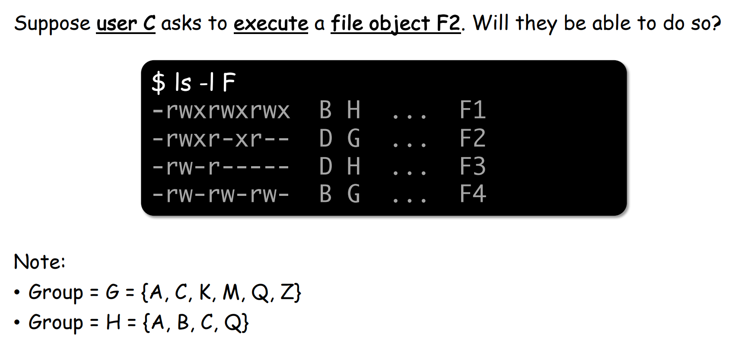
Unix File Modes and Permissions
[file type][user][group][other]

Slide 24


Unix File Modes and Permissions
[file type][user][group][other]

Slide 25
Limitations of File-Based Access Control
When would a non-privilege user require more power/permissions?

Slide 26
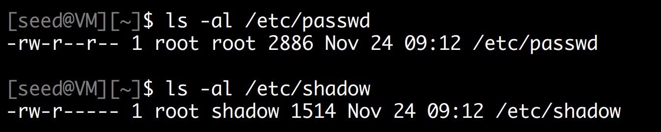

Limitations of File-Based Access Control
When would a non-privilege user require more power/permissions?
Changing password!

Slide 27
Limitations of File-Based Access Control
When would a non-privilege user require more power/permissions?
Changing password!
/etc/passwd and /etc/shadow hold encrypted passwords for the user, in order to change our password, we will need to have access to those directories

Slide 28
Limitations of File-Based Access Control
When would a non-privilege user require more power/permissions?
Changing password!
/etc/passwd and /etc/shadow hold encrypted passwords for the user, in order to change our password, we will need to have access to those directories
root (aka admin) is the only person that has write permissions!

Slide 29
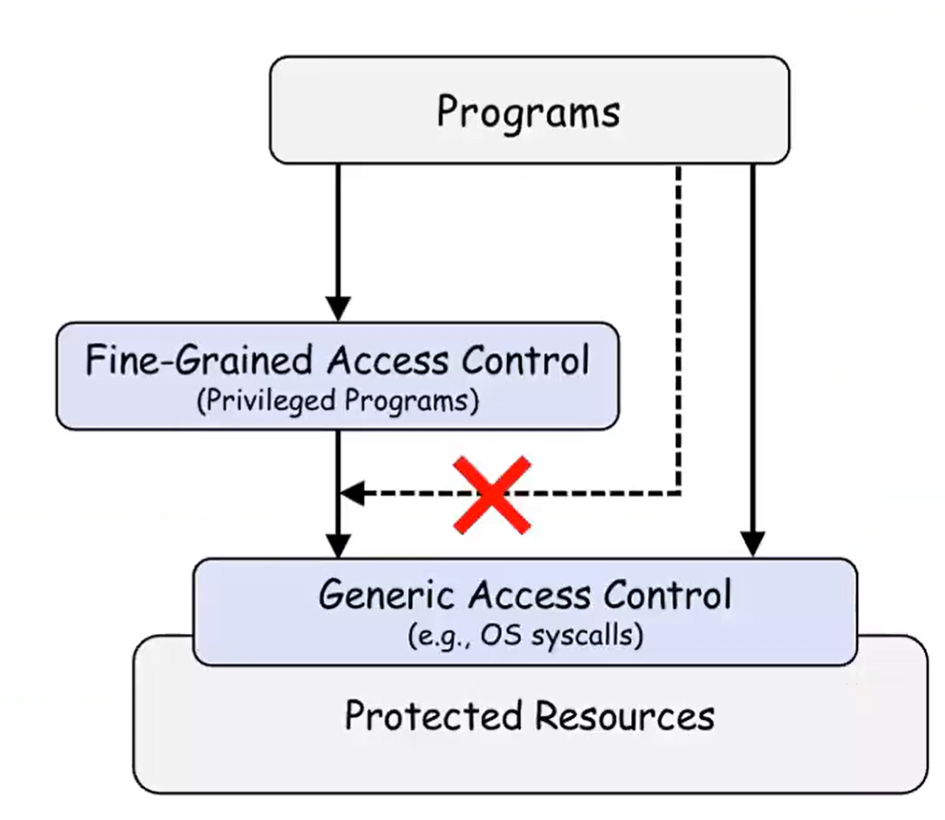

Limitations of File-Based Access Control
Instead of having a user deal with sensitive actions, lets have a privileged program do it for us!

Slide 30
Types of Privileged Programs
Daemons
Computer program that runs in the background
Needs to run as root or other privileged users
Set-UID Programs
Widely used in UNIX systems
A normal program… but marked with a special bit

Slide 31


The superman story
Superman got tired of saving the city every day
So, he decided to create a “super suit” that would give normal people his powers
Problem: Not all super people are good………

Slide 32
The superman story
Superman got tired of saving the city every day
So, he decided to create a “super suit” that would give normal people his powers
Problem: Not all super people are good………
Super suit 2.0
Super suit with a dope computer
Programmed to perform a specific task
No way to deviate from the pre-programmed task

Slide 33
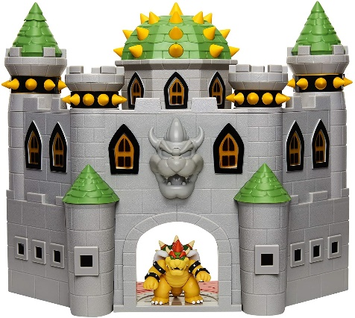


The superman story
Task: Stop Bowser
Fly North
Turn left and move forward
Punch
Super suit 2.0
People can hop in, and do the specific task to stop bowser

Slide 34
The superman story
Task: Stop Bowser
Fly North
Turn left and move forward
Punch

Slide 35

The superman story
Task: Stop Bowser
Fly North
Turn left and move forward
Punch

Slide 36
The superman story
Task: Stop Bowser
Fly North
Turn left and move forward
Punch

Slide 37
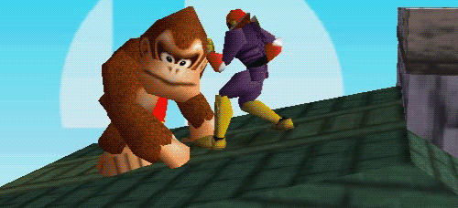
The superman story
Task: Stop Bowser
Fly North
Turn left and move forward
Punch

Slide 38
The superman story
Task: Stop Bowser
Fly North
Turn left and move forward
Punch
This works great! People can only do the predetermined task and don’t have control!

Slide 39
The superman story
Task: Stop Bowser
Fly North
Turn left and move forward
Punch
This works great! People can only do the predetermined task and don’t have control!
Exploitable?

Slide 40

The superman story
Task: Stop Bowser
Fly North
Turn left and move forward
Punch
Suppose I come along, and I see the power suit
And I decide to flip the suit around
Now what happens???

Slide 41
The superman story
Task: Stop Bowser
Fly North
Turn left and move forward
Punch
Suppose I come along, and I see the power suit
And I decide to flip the suit around
Now what happens???

Slide 42
The superman story
Task: Stop Bowser
Fly North
Turn left and move forward
Punch
Suppose I come along, and I see the power suit
And I decide to flip the suit around
Now what happens???

Slide 43
The superman story
Task: Stop Bowser
Fly North
Turn left and move forward
Punch
Suppose I come along, and I see the power suit
And I decide to flip the suit around
Now what happens???

Slide 44
The superman story
Task: Stop Bowser
Fly North
Turn left and move forward
Punch
Suppose I come along, and I see the power suit
And I decide to flip the suit around
Now what happens???

Slide 45

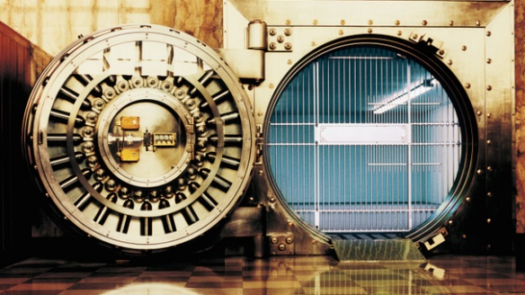
The superman story
Task: Stop Bowser
Fly North
Turn left and move forward
Punch
Suppose I come along, and I see the power suit
And I decide to flip the suit around
I still followed the steps, but now we have a totally different outcome
My plan was to rob the bank, and I had friends waiting this whole time!

Slide 46
Set-UID In a Nutshell
Set-UID allows a user to run a program with the program owner’s privilege
User runs a program w/ temporarily elevated privileges
Created to deal with inflexibilities of UNIX access control
Example: The passwd program

Slide 47

Set-UID In a Nutshell
Set-UID allows a user to run a program with the program owner’s privilege
User runs a program w/ temporarily elevated privileges
Every process has two User IDs
Real UID (RUID)– Identifies the owner of the process
Effective UID (EUID)– Identifies current privilege of the process
When a normal program is executed
RUID == EUID
(If the user created the file)
If a program owner == root,
The program runs with root privileges
When a Set-UID program is executed
RUID != EUID
EUID == ID of the program’s owner

Slide 48
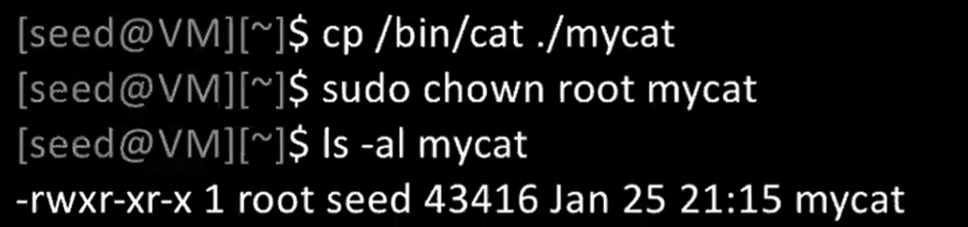
Set-UID Program Demo
Change the owner of a file to root

Slide 49
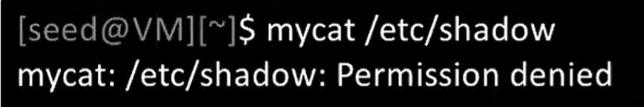
Set-UID Program Demo
Change the owner of a file to root
Running to program (normally)

Slide 50
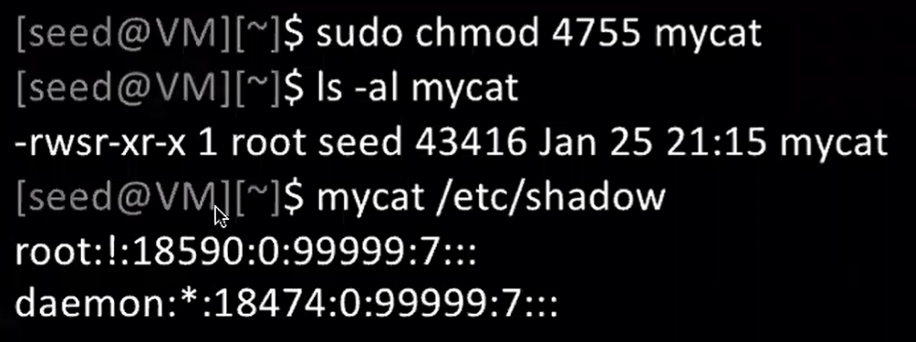

Set-UID Program Demo
Change the owner of a file to root
Running to program (normally)
Enable the Set-UID bit
We have successfully made a Set-UID program!

Slide 51
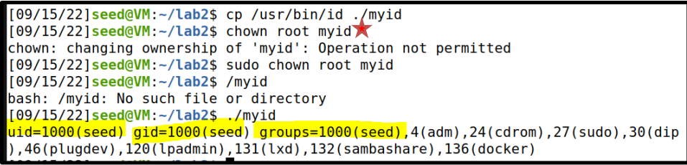
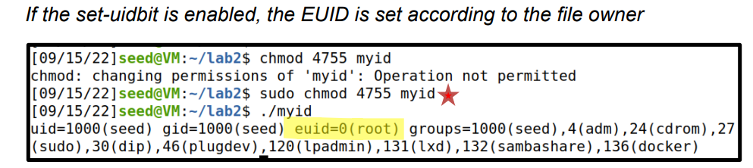
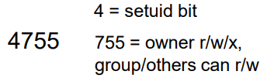
A Set-UID program is just like any other program, except that is has a special bit set
Steps for creating a set-uid program
Change file ownership to root (chown)
2. Enable to Set-uid bit (chmod)
Access control decisions made based on EUID, not RUID !

Slide 52
So…. Is Set-UID secure?
Allows normal users to escalate privileges
➢ This is different from directly giving escalated privileges (such as sudo)
➢ Restricted behavior (think power suit 2.0)
Are there any programs that should not be Set-UID programs?

Slide 53
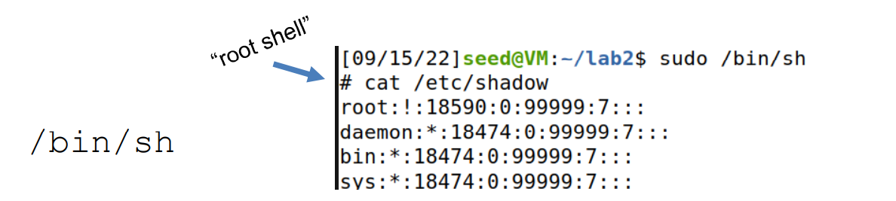
So…. Is Set-UID secure?
Allows normal users to escalate privileges
➢ This is different from directly giving escalated privileges (such as sudo)
➢ Restricted behavior (think power suit 2.0)
Are there any programs that should not be Set-UID programs?

Slide 54
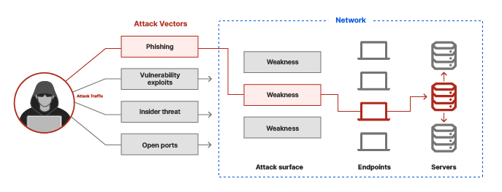
Attack Surface of (Set-UID) Programs
An attack surface is the aggregation of all exposed entry points/weaknesses into the system to gain unauthorized access

Slide 55
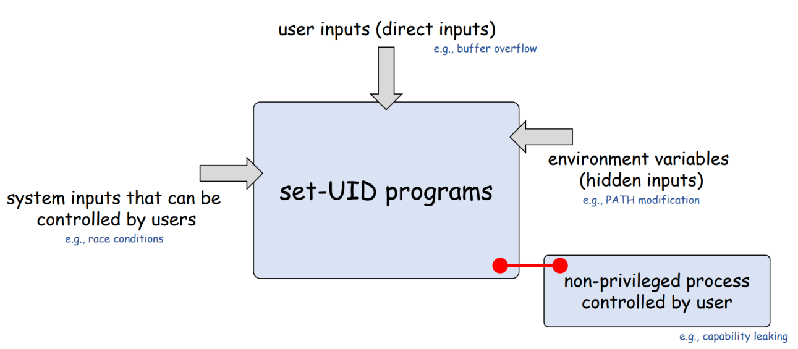
Attack Surface of (Set-UID) Programs
An attack surface is the aggregation of all exposed entry points/weaknesses into the system to gain unauthorized access

Slide 56

Attack Surface of (Set-UID) Programs
An attack surface is the aggregation of all exposed entry points/weaknesses into the system to gain unauthorized access

Slide 57

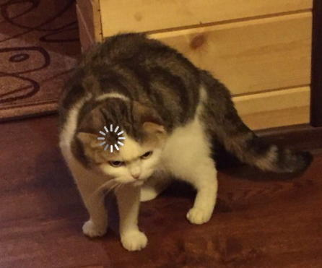

Invoking Programs from within programs

Slide 58

Before we get started….
We need to disable a countermeasure on our OS, and set our shell (/bin/sh) to be an unsafe version
/bin/sh is an alias for /bin/dash. /bin/dash has countermeasures for some of our attacks

Slide 59
Invoking a program with a program
We can invoke external commands/programs from INSIDE another program
system()
exec()-family

Slide 60
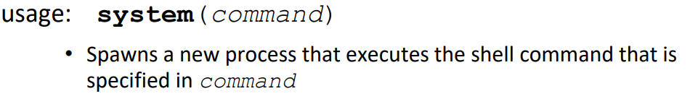
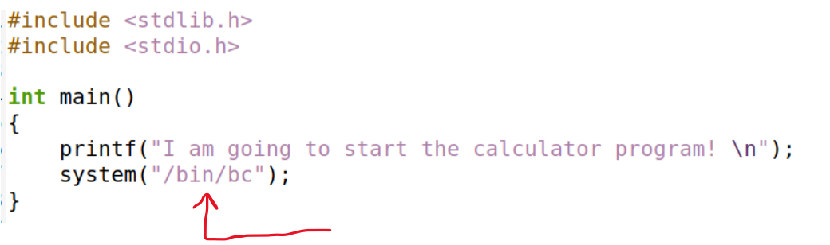
System()

Slide 61
audit Set UID program
Suppose you are preparing for an audit. An auditor may need the access to view certain files.
Instead of giving them total access to everything on the system, we will create a privileged program that will the auditor view the content of some file
Set-UID program name
Name of file the auditor will view
./audit company_data.csv
./audit ../lab0/solution.docx

Slide 62
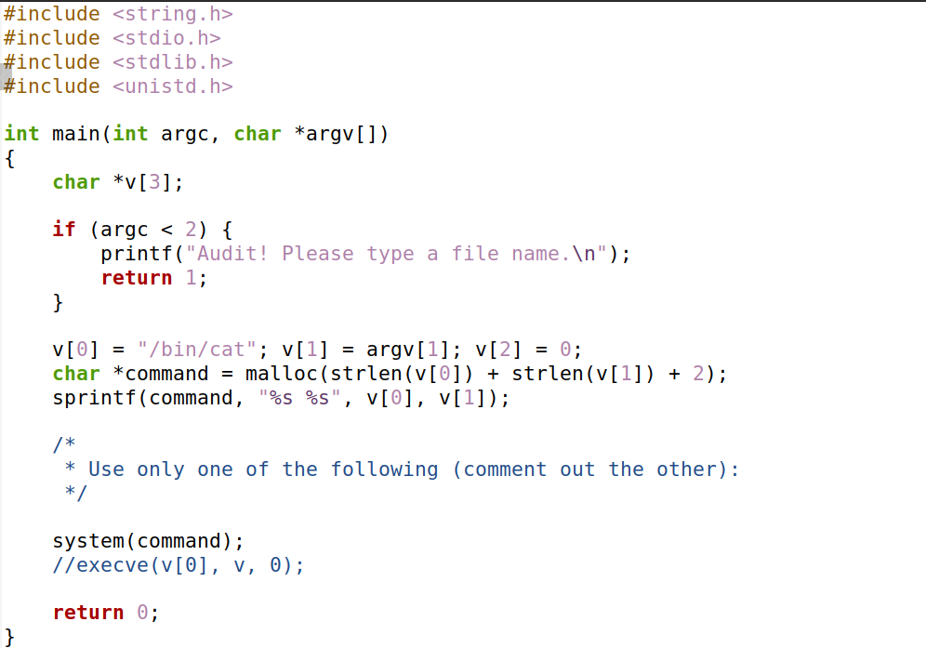
catall.c
The command line argument (file path) is appended to the string “/bin/cat”
Spawns a new process that executes:
/bin/cat [FILE_PATH]
ex. /bin/cat my_file.txt

Slide 63
Suppose you are preparing for an audit. An auditor may need the access to view certain files.
Instead of giving them total access to everything on the system, we will create a privileged program that will the auditor view the content of some file
Set-UID program name
Name of file the auditor will view
./audit company_data.csv
./audit ../lab0/solution.docx
/bin/cat company_data.csv
/bin/cat ../lab0/solution.docx

Slide 64
Suppose you are preparing for an audit. An auditor may need the access to view certain files.
Instead of giving them total access to everything on the system, we will create a privileged program that will the auditor view the content of some file
Set-UID program name
Name of file the auditor will view
./audit company_data.csv
./audit ../lab0/solution.docx
/bin/cat company_data.csv
/bin/cat ../lab0/solution.docx
!!! We have some control over the behavior of this program

Slide 65
!!! We have some control over the behavior of this program
Program Input:
./audit company_data.csv
Command Executed
/bin/cat company_data.csv
Because this is a SET-UID program, things can get very interesting

Slide 66
system() is a very unsafe function
We can exploit this by maliciously constructing the input to this program
Hint: the string passed to system() can include multiple commands

Slide 67
system() is a very unsafe function
We can exploit this by maliciously constructing the input to this program
Hint: the string passed to system() can include multiple commands
./audit “my_info.txt; /bin/sh”

Slide 68
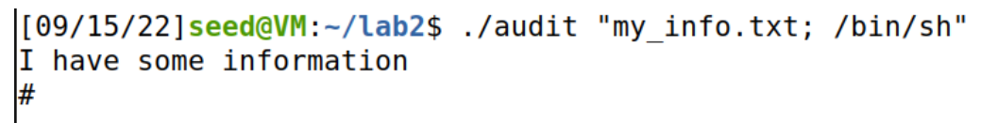
./audit “my_info.txt; /bin/sh”
system(/bin/cat my_info.txt; /bin/sh)
system() interprets this as two separate commands

Slide 69




./audit “my_info.txt; /bin/sh”
system(/bin/cat my_info.txt; /bin/sh)
system() interprets this as two separate commands

Slide 70
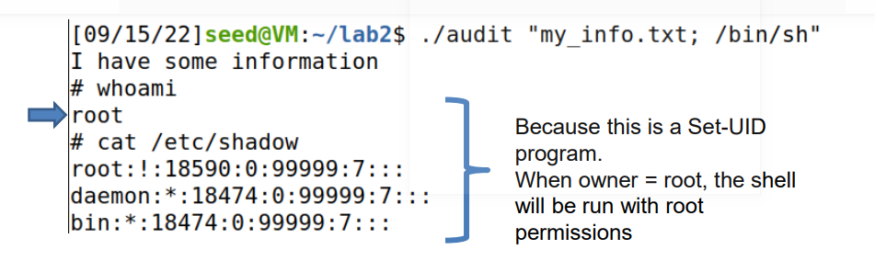



./audit “my_info.txt; /bin/sh”
system(/bin/cat my_info.txt; /bin/sh)

Slide 71


./audit “my_info.txt; /bin/sh”
system(/bin/cat my_info.txt; /bin/sh)
We have gained access into the system

